Slide 1
RC_week2
Yixuan Wang
2018/9/19

Slide 2
Content
Introduction
Revision
Common Questions
Exercise

Slide 3
Introduction
About assignment
Tips
Listen to lectures!!!
Practice hard and think hard!!!
Become used to English material!!!
Be brave to ask questions!!!
Don’t fall behind!!! (very very very dangerous)
Review in time
Preview

Slide 4

Revision
upper bound / lower bound / bounded
supreme / infimum (not necessarily belonging to the set)
$δ$-neighborhood of x / neighborhood
open set (2 definitions) / closed set
intersection / union
$∅$ and $ℝ$ (both)
[2,3) (neither)
all points are interior points $⟺$ open sets
a point is not interior points $⟺$ closed sets / neither
Compact set
open
inconclusive
open
intersection
union
closed
inconclusive
closed

Slide 5
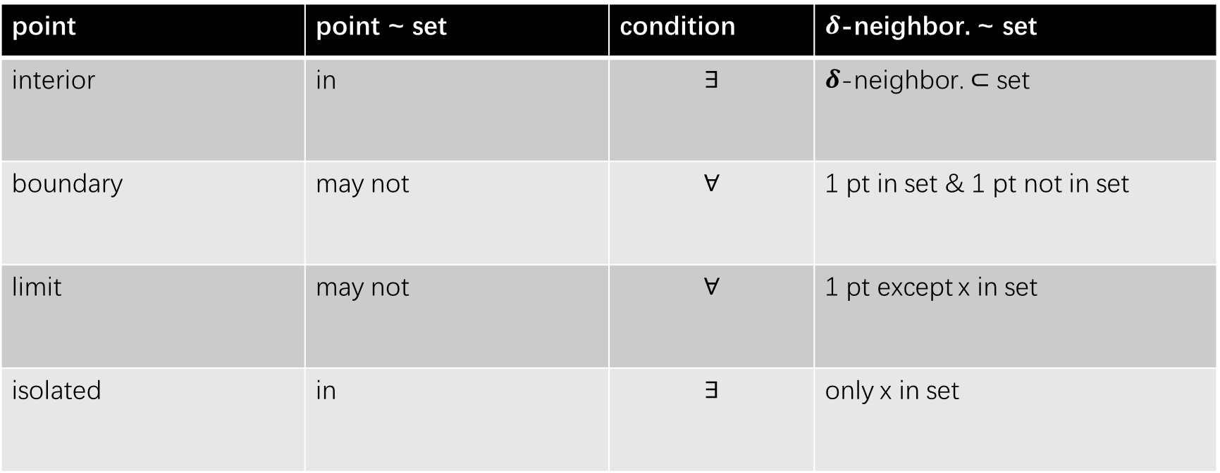
Revision
point | point ~ set | condition | $δ$-neighbor. ~ set
interior | in | $$∃$$ | $δ$-neighbor. $⊂$ set
boundary | may not | $$∀$$ | 1 pt in set & 1 pt not in set
limit | may not | $$∀$$ | 1 pt except x in set
isolated | in | $$∃$$ | only x in set

Slide 6
Revision
NOTE: pay attention to similar concepts and compare them
Example: draw the relationship between interior point, boundary point, limit point and isolated point (just one format)
Boundary Point
Interior Point
Limit Point
Isolated Point

Slide 7
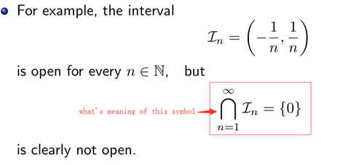
Common Questions
What is exterior (interior of complementary set of D)
For this proof
About this question

Slide 8
Exercise
Refer to worksheet

